Slide 1
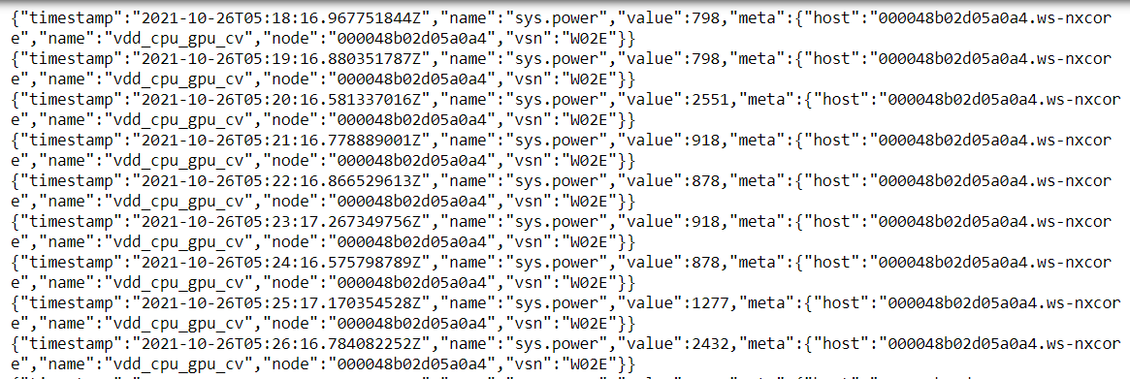
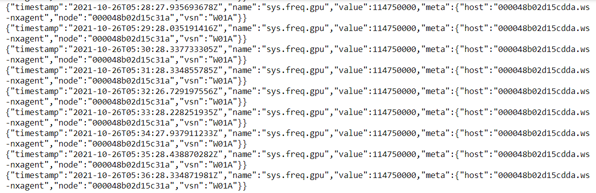
Sys.power
Sys.freq.gpu

Slide 2
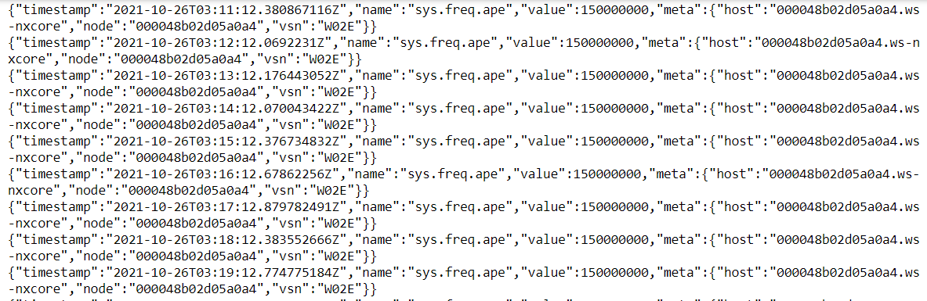
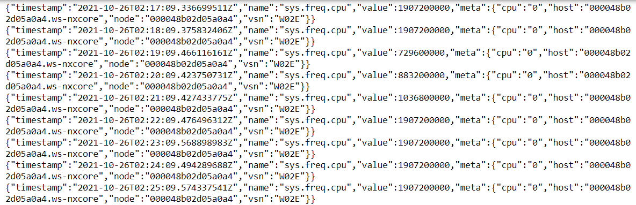
Sys.freq.ape
Sys.freq.cpu

Slide 3
Questions that I have
How could I parse specific values from multiple JSON objects so that I can plot them?
Whenever I tried to parse values for specific data of the sensor (such as the CPU frequency, power, etc.), I get this error: JSONDecodeError extra data line 2 column 1, within Jupyter Notebook
Last time we met, InfluxDB was mentioned. Do you have a tutorial on how I could use that to plot data outside of using something like matplotlib?
Apologies in advance if this meeting is very lackluster, as I have been very busy, and a bit stressed out with school projects that have been taking a lot of time lately.

